Slide 1
Presentation 9
SEAWAT Concepts
Notes:
SEAWAT Training Course
Lecture 9

Slide 2
SEAWAT Concept
Combine MODFLOW and MT3DMS into a single program
  Insert MT3DMS into MODFLOW main program
Modify MODFLOW routines to solve the variable-density groundwater flow equation

Slide 3
Programming Objectives
Accurate
Modular
Minimal changes to existing MODFLOW and MT3D subroutines

Slide 4
SEAWAT Processes
Global (GLO) Process
Ground-Water Flow (GWF) Process
Variable-Density Flow (VDF) Process
  Viscosity (VSC) Package
Integrated MT3DMS Transport (IMT) Process
Observation (OBS) Process
Sensitivity (SEN) Process
Parameters Estimation (PES) Process

Slide 5
Global Process
Not really a process (doesn’t solve an equation)
Simulation modes and process compatibility
Program structure
Discretization
  Spatial
  Temporal

Slide 6
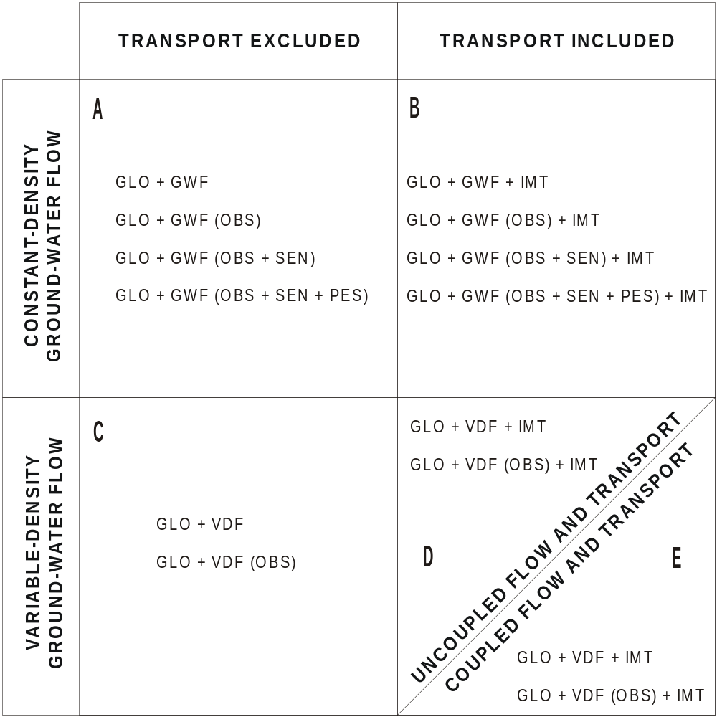
Simulation Modes

Slide 7
Optional Simulation Mode: VDF without Transport
User enters 3D array of fluid density
Caution—assumption is that fluid density will not change during the simulation period
Advantage: simulations run quickly because not limited by stability requirements for transport equation

Slide 8
Process Compatibility
VDF not compatible with SEN and PES
  Cannot use in same simulation
VDF is compatible with OBS
IMT not compatible with OBS, SEN, and PES
  Can be used during same simulation—do not interfere with each other

Slide 9
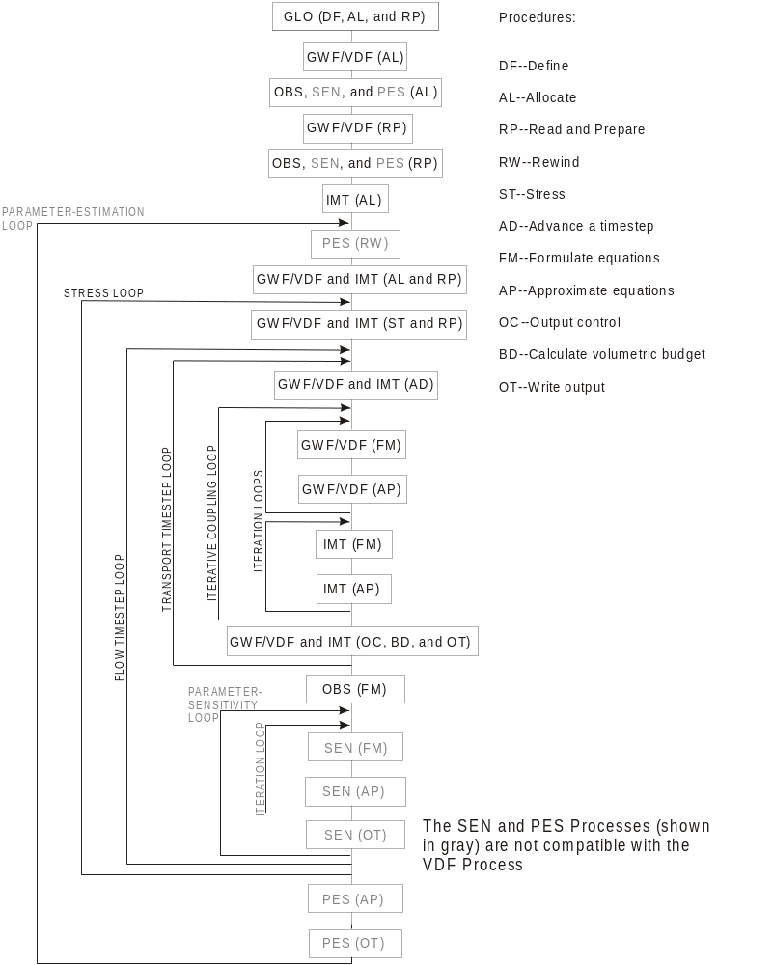
Program
Structure

Slide 10
Spatial Discretization
Information must be consistent between MODFLOW and MT3D
Higher level of vertical discretization required for variable-density groundwater flow (rule of thumb—~10 layers per aquifer)

Slide 11
Temporal Discretization
Stress periods
Flow timesteps
Transport timesteps
Flow and transport equations solved for each transport timestep
Transport timesteps
1
2
3
4
5
1
2
3
4
1
2
3
4
1
2
3
4
1
1
2
1
1
2
1
2
3
ts1
ts1
ts2
ts3
ts1
ts2
ts3
ts4
ts5
time
STRESS PERIOD 1
STRESS PERIOD 2
STRESS PERIOD 3

Slide 12
Options for Coupling Flow and Transport
Explicit—one timestep lag
  Works well for most problems
Implicit—iterative coupling until convergence on fluid density
  Can only be used if transport is solved using implicit finite difference
  Can be time consuming and doesn’t seem to help with accuracy for problems tested thus far

Slide 13
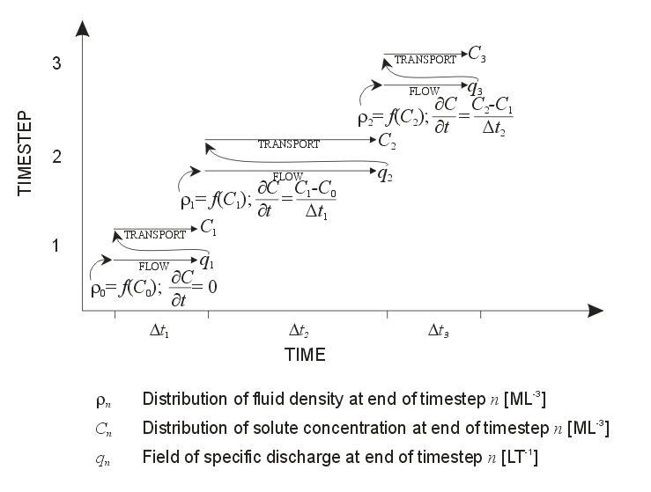
Explicit Coupling

Slide 14
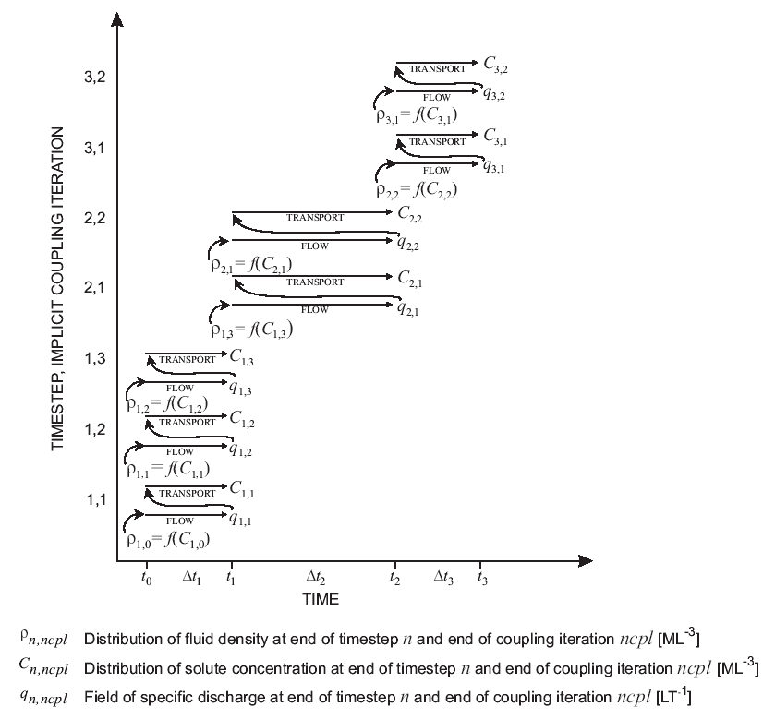
Implicit Coupling

Slide 15
Flow Field Update Control
Recalculate the flow field only if the density has changed by a user-specified density value
May substantially improve computer runtimes
Should probably avoid for sensitivity analyses and parameter estimation

Slide 16
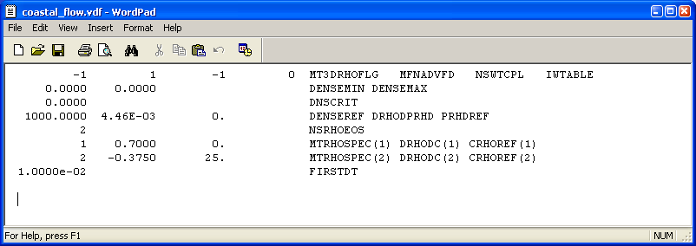
How it Works
Flow equation will be solved if:
  the density change since the last flow field update exceeds DNSCRIT
  it is the first transport timestep of the simulation
  it is the last transport timestep of a flow timestep

Slide 17
Example
Example of how the flow field update control would work with a very large value for DNSCRIT (10 flow solutions instead of 26)
1
2
3
4
5
1
2
3
4
1
2
3
4
1
2
3
4
1
1
2
1
1
2
1
2
3
ts1
ts1
ts2
ts3
ts1
ts2
ts3
ts4
ts5
time
STRESS PERIOD 1
STRESS PERIOD 2
STRESS PERIOD 3

Slide 18
Variable-Density Flow (VDF) Process
Alternative to GWF Process
Uses modified and unmodified routines from GWF
Compatible with GLO, IMT and OBS
Not compatible with SEN or PES

Slide 19
Integrated MT3DMS Transport (IMT) Process
No substantial changes to original MT3DMS source code
For variable-density simulations, transport equation should contain density gradient terms—these are not included in SEAWAT
  Not a problem for simulations in range between freshwater and seawater
  Could be important for brine transport

Slide 20
Observation Process (OBS)
Variable-density form of Darcy’s Law used to calculate simulated equivalents

Slide 21
Compiling and Compiling Issues
Currently using Intel Visual Fortran Version 11.1 integrated with Microsoft Visual Studio 2008
Use compiler switch to force real variables as double precision (in previous version of SEAWAT, this was done use FORTRAN statement DOUBLE PRECISION
  As a result, output routines are modified to write as single precision for compatibility with other software
Using “true binary” structure for unformatted files
  Compatible with Groundwater Vistas
  Used in MODFLOW-2000

